Slide 1
Chapter 15
Economics and Justification
of Electronic Commerce

Slide 2
Learning Objectives
Describe the need for justifying EC investments, how it is done, and how metrics are used to determine justification.
Understand the difficulties in measuring and justifying EC investments.
Recognize the difficulties in establishing intangible metrics and describe how to overcome them.
List and briefly describe traditional and advanced methods of justifying IT investments.

Slide 3
Learning Objectives
Understand how e-CRM, e-learning, and other EC projects are justified.
Describe some economic principles of EC.
Understand how product, industry, seller, and buyer characteristics impact the economics of EC.
Recognize key factors in the success of EC projects and the major reasons for failures.

Slide 4
Why Justify E-Commerce Investments; How Can They Be Justified?
Increased Demand for Financial Justification
  IT executives feel the demand for financial justification and planning from executives but:
    65% of companies lack the knowledge or tools to do ROI calculations
    75% have no formal processes or budgets in place for measuring ROI
    68% do not measure how projects coincide with promised benefits six months after completion

Slide 5
Why Justify E-Commerce Investments; How Can They Be Justified?
Other Reasons Why EC Justification Is Needed
  Companies realize that EC is not necessarily the solution to all problems
  A formal evaluation of requests for funding is mandated
  Companies need to assess the success of EC projects after completion, and later on a periodic basis
  The success of EC projects may be assessed in order to pay bonuses

Slide 6
Why Justify E-Commerce Investments; How Can They Be Justified?
EC Investment Categories and Benefits
  IT infrastructure provides the foundation for EC applications in the enterprise
  EC applications are specific systems and programs for achieving certain objectives

Slide 7
Why Justify E-Commerce Investments; How Can They Be Justified?
  Specific benefits
    Cost reduction
    Productivity improvement
    Improved customer satisfaction
    Improved staffing levels
    Higher revenues
    Higher earnings
    Better customer
    Retention
    More return of equity
    Faster time-to-market

Slide 8
Why Justify E-Commerce Investments; How Can They Be Justified?
How Is an EC Investment Justified?
  cost-benefit analysis
  A comparison of the costs of a project against the benefits
  Business justification and business case

Slide 9
Why Justify E-Commerce Investments; How Can They Be Justified?
What Needs to Be Justified? When Should Justification Take Place?
  When the value of the investment is relatively small for the organization
  When the relevant data are not available, are inaccurate, or are too volatile
  When the EC project is mandated

Slide 10
Why Justify E-Commerce Investments; How Can They Be Justified?
Using Metrics in EC Justification
  metric
  A specific, measurable standard against which actual performance is compared

Slide 11
Why Justify E-Commerce Investments; How Can They Be Justified?
Using Metrics in EC Justification
  Metrics can:
    Define the value proposition of business models
    Communicate a business strategy to the workforce
    Increase accountability
    Align the objectives of individuals, departments, and divisions to the enterprise’s strategic objectives
    Track the performance of EC systems
    Assess the health of companies

Slide 12
Why Justify E-Commerce Investments; How Can They Be Justified?
Metrics, measurements, and key performance indicators
  key performance indicators (KPI)
  The quantitative expression of critically important metrics

Slide 13
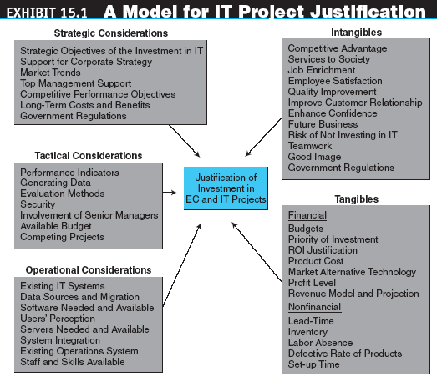
Difficulties in Measuring and Justifying E-Commerce Investments

Slide 14
Difficulties in Measuring and Justifying E-Commerce Investments
Difficulties in Measuring Productivity and Performance Gains
  Data and analysis issues
  EC productivity gains may be offset by losses in other areas
  Incorrectly defining what is measured
  Other difficulties

Slide 15
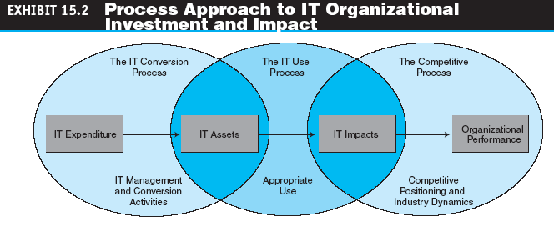
Difficulties in Measuring and Justifying E-Commerce Investments

Slide 16
Difficulties in Measuring and Justifying E-Commerce Investments
Difficulties in Measuring Intangible Costs and Benefits
  Tangible costs and benefits
  Intangible costs and benefits
  Handling intangible benefits
  Handling uncertainties

Slide 17
Difficulties in Measuring and Justifying E-Commerce Investments
The Process of Justifying EC and IT Projects
  Lay an appropriate foundation for analysis with your vendor, and then conduct your ROI
  Conduct a good research on metrics and validate them
  Justify and document the cost and benefit assumptions
  Document and verify all figures used in the calculation
  Do not leave out strategic benefits
  Be careful not to underestimate cost and overestimate benefits
  Make figures as realistic as possible and include risk analysis
  Commit all partners, including vendors and top management

Slide 18
Methods and Tools for Evaluating and Justifying E-Commerce Investments
Opportunities and Revenue Generated by EC Investment
  A major difficulty in assessing the EC value is the measurement of possible benefits that drive EC investment
  Some of these are opportunities that may or may not materialize, so there is only a certain probability for return on the EC investment known as the opportunity matrix

Slide 19
Methods and Tools for Evaluating and Justifying E-Commerce Investments
Methodological Aspects of Justifying EC Investments
  Types of costs
    Distinguish between initial (up-front) costs and operating costs
    Direct and indirect share costs
    In-kind costs

Slide 20
Methods and Tools for Evaluating and Justifying E-Commerce Investments
Traditional Methods for Evaluating EC Investments
  ROI method
  Payback period

Slide 21
Methods and Tools for Evaluating and Justifying E-Commerce Investments
Net Present Value (NPV)
  Business ROI
  Technology ROI
  ROI calculator
  Calculator that uses metrics and formulas to compute ROI
  Internal rate of return (IRR)

Slide 22
Methods and Tools for Evaluating and Justifying E-Commerce Investments
  Break-even analyses
  total cost of ownership (TCO)
  A formula for calculating the cost of owning, operating, and controlling an IT system

Slide 23
Methods and Tools for Evaluating and Justifying E-Commerce Investments
  total benefits of ownership (TBO)
  Benefits of ownership that include both tangible and intangible benefits
  Economic value added
  Using several traditional methods

Slide 24
Methods and Tools for Evaluating and Justifying E-Commerce Investments
Advanced Methods for Evaluating IT and EC Investments
  Financial approaches
  Multicriteria approaches
  Ratio approaches
  Portfolio approaches

Slide 25
Examples of
E-Commerce Project Justification
E-PROCUREMENT
  E-procurement encompasses buying and selling, selecting suppliers, submitting formal requests for goods and services to suppliers, getting approval from buyers, processing purchase orders, fulfilling orders, delivering and receiving items, and processing payments
  The diversity of activities involved in
  e-procurement, the metrics used to measure the value of e-procurement must reflect how well each process is accomplished

Slide 26
Examples of
E-Commerce Project Justification
Customer Service and eCRM
  Only a small percentage of companies have demonstrated a significantly positive ROI for their eCRM investments
  CRM-based EC applications are most effective when they are part of a company’s overall business plan and not just an EC investment

Slide 27
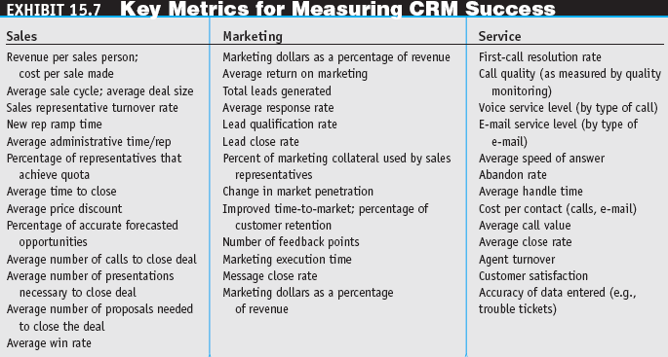
Examples of
E-Commerce Project Justification

Slide 28
Examples of
E-Commerce Project Justification
Justifying a Portal
  The fundamental business case should be made from the internal and external perspectives of the business
  The internal payoff must result in productivity improvements, whereas revenue generation determines the external value

Slide 29
Examples of
E-Commerce Project Justification
Justifying E-Training Projects
  End-user training that helps employees acquire or improve their EC and IT skills plays a key role in ensuring the smooth operation of organizations in the information economy

Slide 30
Examples of
E-Commerce Project Justification
Justifying an Investment in Mobile Computing and in RFID
  Justifying the cost of mobile computing may be difficult due to cost sharing and intangible benefits
  These calculations are helpful:
    Return on the wireless workforce
    Return on outsourcing mobile device management
    Cost of the wireless networks

Slide 31
Examples of
E-Commerce Project Justification
Justifying Security Projects
  More than 85% of viruses enter business networks via e-mail. Cleaning up infections is labor intensive, but antivirus scanning is not
  Employee security training is usually poorly done
Calculating the Cost of the Sarbanes-Oxley Act

Slide 32
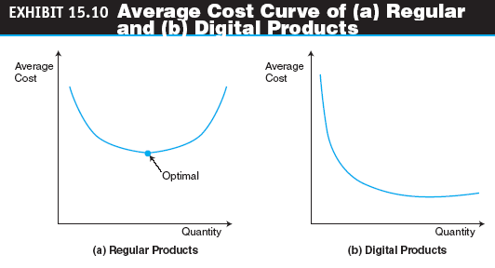
The Economics of E-Commerce

Slide 33
The Economics of E-Commerce
Reducing Production Costs
  Product cost curves
    average-cost curve (AVC)
    Behavior of average costs as quantity changes; generally, as quantity increases, average costs decline
  production function
  An equation indicating that for the same quantity of production, Q, companies either can use a certain amount of labor or invest in more automation

Slide 34
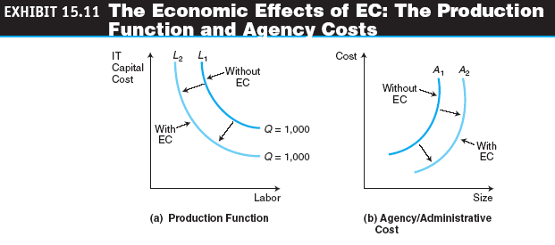
The Economics of E-Commerce

Slide 35
The Economics of E-Commerce
  agency costs
  Costs incurred in ensuring that the agent performs tasks as expected (also called administrative costs)
  transaction costs
  Costs that are associated with the distribution (sale) or exchange of products and services including the cost of searching for buyers and sellers, gathering information, negotiating, decision making, monitoring the exchange of goods, and legal fees

Slide 36
The Economics of E-Commerce
Increased Revenues
  Reach versus richness
  Other ways to increase revenues

Slide 37
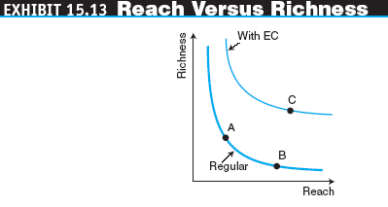
The Economics of E-Commerce

Slide 38
The Economics of E-Commerce
Reducing Transaction Friction or Risk
  Organizations can increase the value of their products or services by using the unique capabilities of EC to reduce risks to consumers, such as those involving psychological relationships, quality concerns, delays, and financial transactions

Slide 39
The Economics of E-Commerce
Facilitating Product Differentiation
  product differentiation
  Special features available in products that make them distinguishable from other products. This property attracts customers that appreciate what they consider an added value

Slide 40
The Economics of E-Commerce
EC Increases Agility
  agility
  An EC firm’s ability to capture, report and quickly respond to changes happening in the marketplace and business environment
Markets versus E-Markets
  Even if the flow of physical goods does not decrease, the information provided in e-markets better informs participants and, therefore, allows them to make better decisions

Slide 41
The Economics of E-Commerce
Valuation of EC Companies
  valuation
  The fair market value of a business or the price at which a property would change hands between a willing buyer and a willing seller who are both informed and under no compulsion to act. For a publicly traded company, the value can be readily obtained by multiplying the selling price of the stock by the number of available shares

Slide 42
The Economics of E-Commerce
  Three most common valuation methods:
    The comparable method
    The financial performance method
    The venture capital method

Slide 43
Factors that Determine
E-Commerce Success
Categories of EC Success
  Product characteristics
  Industry characteristics
  Seller characteristics
  Consumer characteristics

Slide 44
Factors that Determine
E-Commerce Success
The Levels of EC Measurement
  Metrics vary based on whether the level of measurement is:
    An individual EC customer
    An EC firm
    An EC-enabled process
    The EC value chain

Slide 45
Opportunities for Success in
E-Commerce and Avoiding Failure
E-Commerce Failures
  Three economic phenomena suggest why:
    At a macroeconomic level, technological revolutions have had a boom–bust–consolidation cycle
    At a mid-economic level, failures are consistent with periodic economic downturns that have occurred in other areas over the years
    At a microeconomic level, the “Web rush” reflected an over-allocation of scarce resources and too many advertising-driven business models

Slide 46
Opportunities for Success in
E-Commerce and Avoiding Failure
E-Commerce Successes
  Strategies for EC success
  Thousands of brick-and-mortar companies are adding online channels with great success
  Existing firms can use organizational knowledge, brand, infrastructure, and other “morphing strategies” to migrate from the off-line marketplace to the online marketspace

Slide 47
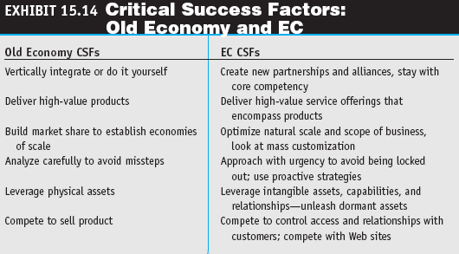
Opportunities for Success in
E-Commerce and Avoiding Failure

Slide 48
Opportunities for Success in
E-Commerce and Avoiding Failure
digital options
A set of IT-enabled capabilities in the form of digitized enterprise work processes and knowledge systems
Complementary investments
Additional investments, such as training, made to maximize the returns from EC investments

Slide 49
Opportunities for Success in
E-Commerce and Avoiding Failure
Cultural Differences and EC
  EC-driven businesses must consider the cultural differences in this diverse global consumer base because without the broad acceptance of the EC channel, consumers may choose not to participate in online transactions
EC in Developing Economies
  Developing economies often face power blackouts, unreliable telecommunications infrastructure, undependable delivery mechanisms, and the fact that only a few customers own computers and credit cards

Slide 50
Managerial Issues
How do we measure the value of EC investment?
What complementary investments will be needed?
Is a shift from tangible to intangible benefits necessary?
Who should conduct a justification?
Should we use the ROI calculator provided by a vendor who wants to sell us an EC system?
How does one know if the valuation of EC companies is justifiable?
Is it possible to predict EC success?

